Slide 1
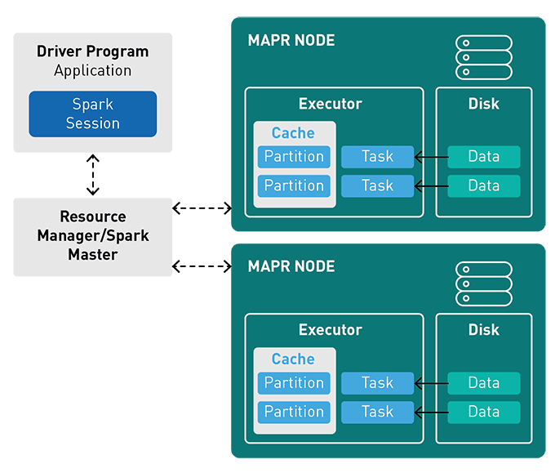
Lab 04 - Spark
https://bit.ly/B23344

